Slide 1
Power system fault detection & classification
CAPSTONE PROJECT
Presented By:
Rishika Agarwal (Graphic Era University)

Slide 2
OUTLINE
Problem Statement
Proposed System/Solution
System Development Approach
Algorithm & Deployment
Result (Output Image)
Conclusion
Future Scope
References

Slide 3
Problem Statement
Design a machine learning model to detect and classify different types of faults in a power distribution system. Using electrical measurement data (e.g., voltage and current phasors), the model should be able to distinguish between normal operating conditions and various fault conditions (such as line-to-ground, line-to-line, or three-phase faults). The objective is to enable rapid and accurate fault identification, which is crucial for maintaining power grid stability and reliability.

Slide 4
Proposed Solution
Data Collection: Gathered simulated and historical voltage/current phasor data, both under fault and nominal conditions, as well as system-related context information
Data Preprocessing: Cleaned, synchronized, and normalized the data; added engineered features such as sequence components, power deviations, and rate of change features.
Machine Learning Model: Utilized IBM watsonx.ai AutoAI to select, train, and tune automatically the optimal multiclass classification model for fault detection.
Deployment: Used the model as a real-time inference service coupled with grid monitoring systems to provide instantaneous fault alerts.
Evaluation: Evaluated performance in terms of precision, recall, F1-score, confusion matrix, and detection latency to minimize false alarms.
Result: Attained high-accuracy, low-latency fault classification for all fault types to improve grid stability and reliability.

Slide 5
System Approach
The system ingests real-time voltage and current phasor data, preprocesses and extracts key features, and uses an AutoAI-trained machine learning model in IBM watsonx.ai to classify operating conditions. The deployed model outputs fault type predictions instantly, triggering alerts for rapid response and grid protection.

Slide 6
Algorithm & Deployment
Algorithm Selection: We used IBM watsonx.ai’s AutoAI to automatically evaluate multiple supervised machine learning algorithms (e.g., Random Forest, Gradient Boosting, Logistic Regression) and select the best-performing model for multiclass fault classification. AutoAI was chosen for its ability to optimize preprocessing, feature engineering, and hyperparameters, ensuring high accuracy and minimal latency.
Data Input: The model uses voltage and current phasor measurements, sequence components (positive, negative, zero), power deviations, rate of change metrics, and system contextual data such as load conditions and topology changes.
Training Process: Historical and simulated labeled data were split into training and test sets, with AutoAI performing automated feature selection, transformation, and hyperparameter tuning. Stratified cross-validation ensured balanced representation of all fault types and improved generalization.
Prediction Process: In real-time operation, incoming phasor measurements are preprocessed and transformed using the same pipeline from training, then passed to the model to classify conditions as normal or specific fault types. The system outputs fault type and confidence score for immediate operator action.

Slide 7
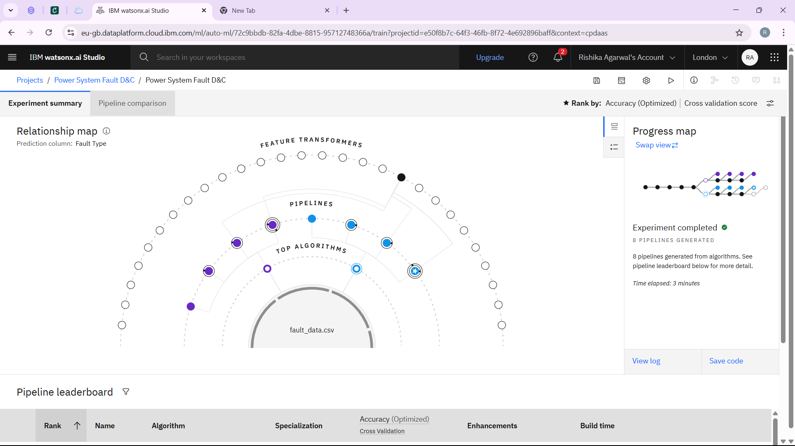
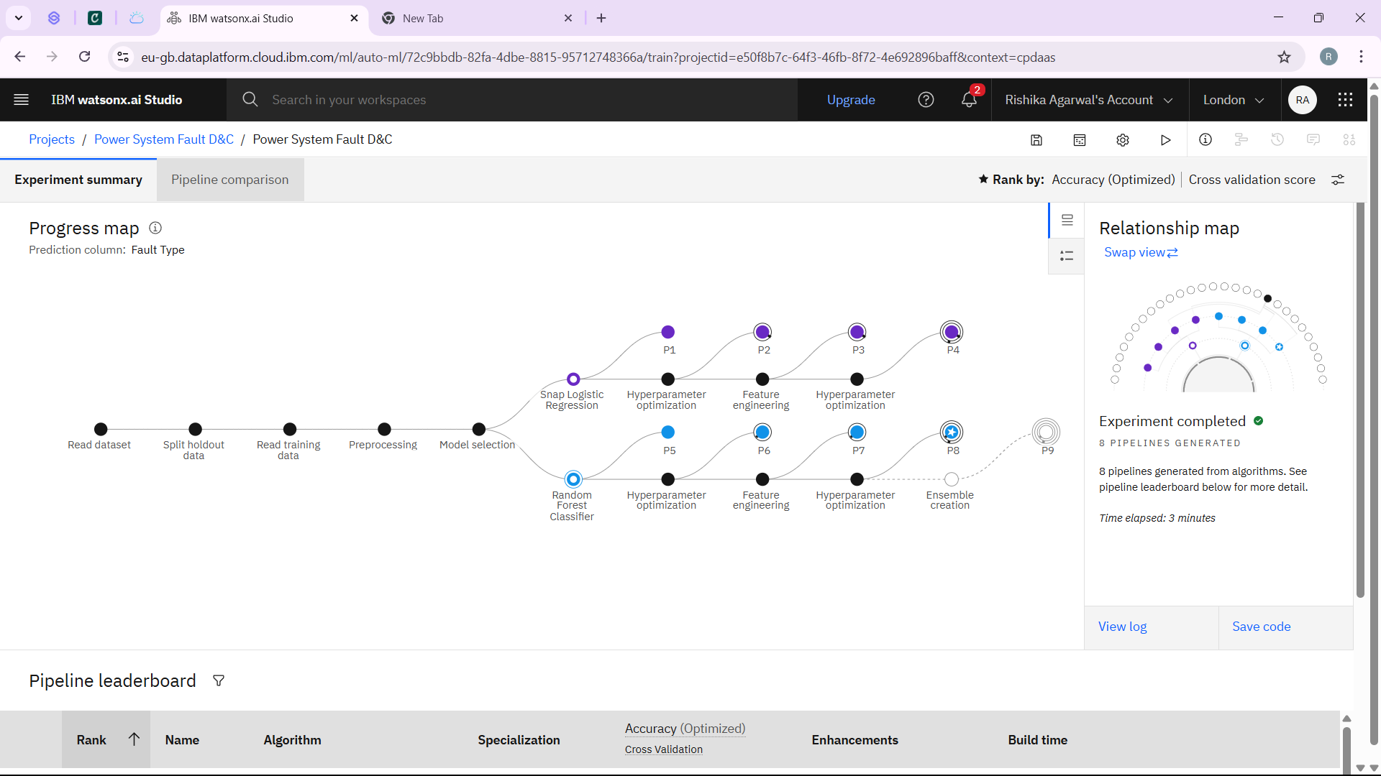
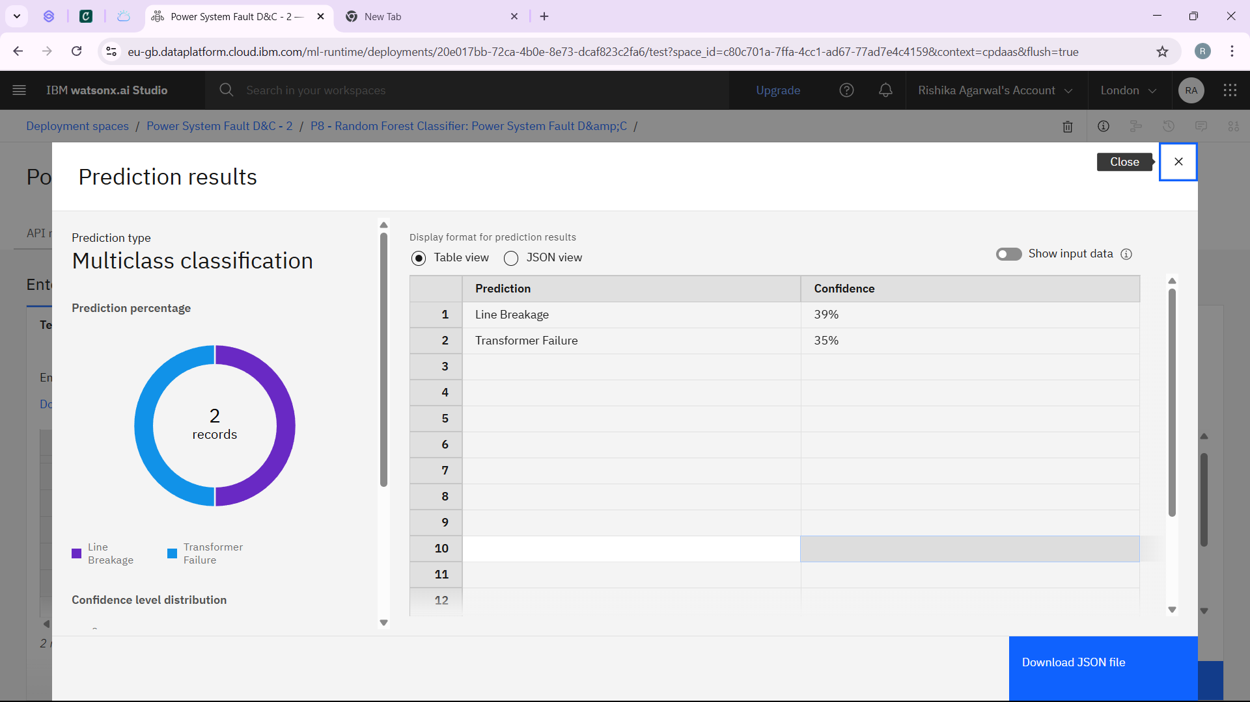
Result

Slide 8
Conclusion
The machine learning-based fault detection system developed using IBM watsonx.ai AutoAI successfully identifies and classifies various power distribution faults with high accuracy and low latency. By leveraging phasor measurement data and automated model optimization, the solution enables rapid fault diagnosis, enhancing grid reliability, reducing downtime, and supporting proactive maintenance.

Slide 9
Future scope
The system can be extended to include fault location estimation, integration with predictive maintenance systems, and adaptation to different grid topologies. Incorporating streaming analytics, IoT sensor networks, and advanced deep learning models can further improve detection accuracy and robustness against evolving grid conditions.

Slide 10
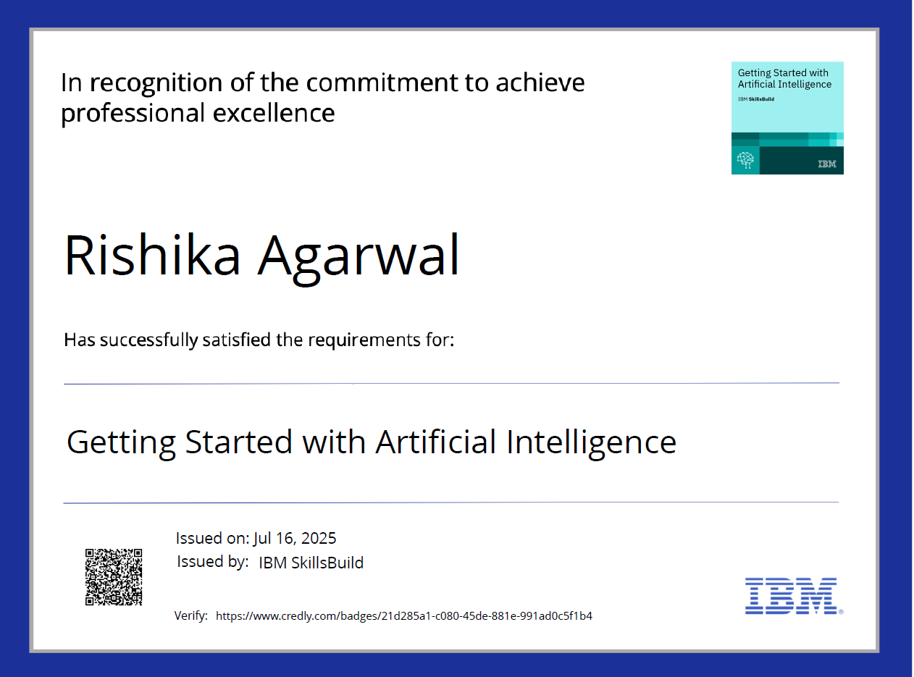
IBM Certifications

Slide 11
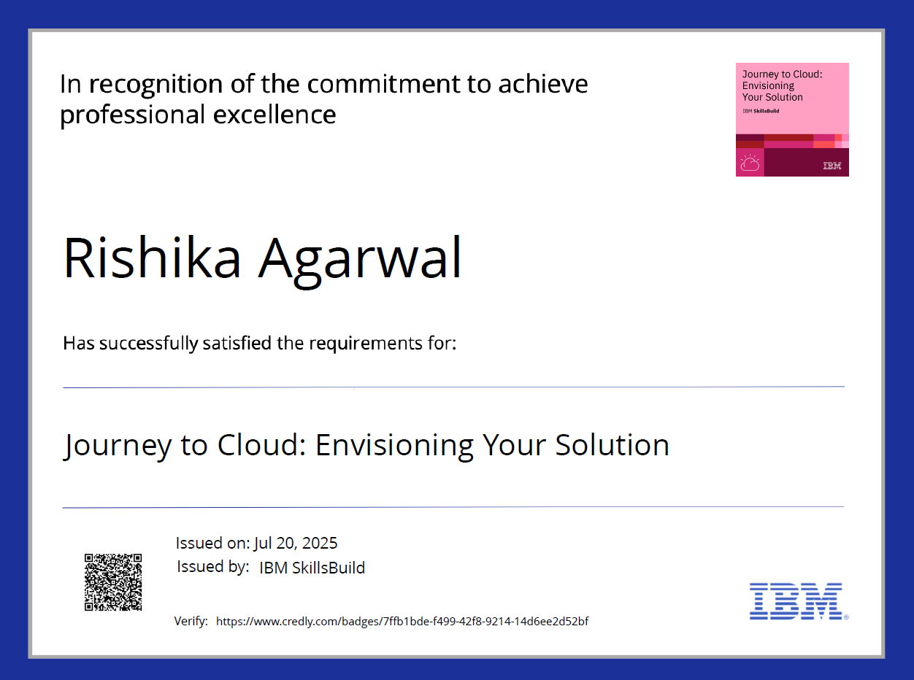
IBM Certifications

Slide 12
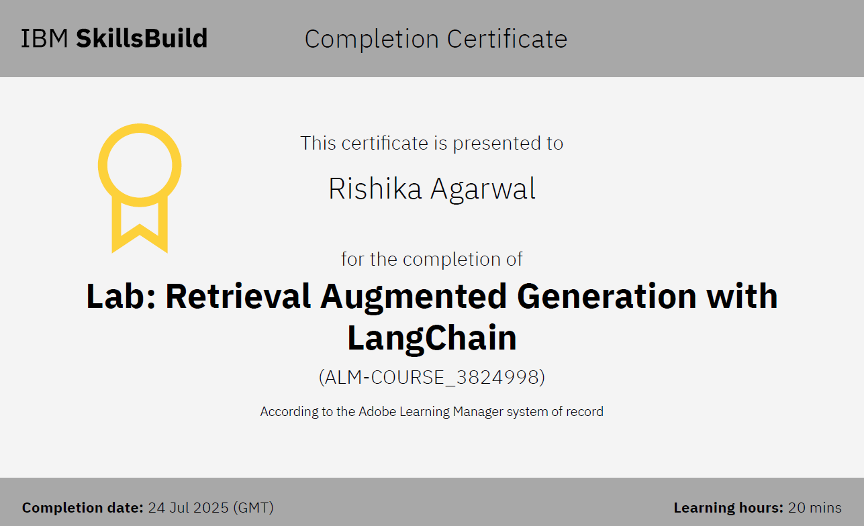
IBM Certifications

Slide 13
THANK YOU

